Slide 1


ACT® Aspire®
Technical Readiness
Online Testing
Notes:
Welcome to the ACT Aspire Technical Readiness training. This training addresses the technical setup required for ACT Aspire assessments. We recommend this training be viewed by Administration Test Coordinators and Test Coordinators, as well as district and school technology staff.

Slide 2




Agenda
ACT Aspire Testing Process
Online Testing - Technical Readiness Steps
Resources and Materials
Accessing and Navigating PearsonAccess^{next}
Notes:
During this training, we’ll review the following topics:
Accessing and Navigating PearsonAccess^{next}
ACT Aspire Testing Process
Online Testing – Technical Readiness Steps
Resources & Materials

Slide 3
Pearsonaccess^{next}
Notes:
Our first topic covers the basics of accessing and navigating PearsonAccess^{next}.

Slide 4
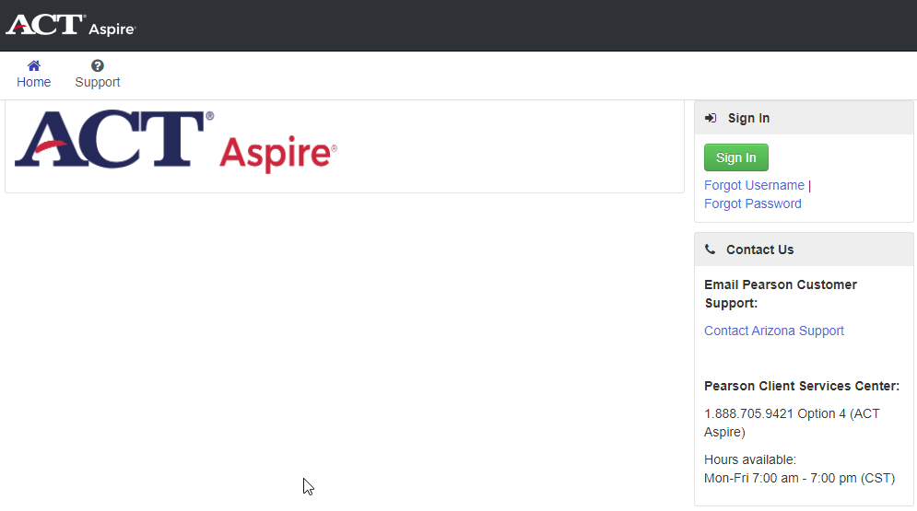
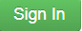

Accessing and Navigating
Accessing PearsonAccess^{next}
aspire.pearsonaccessnext.com
Notes:
This is the login screen for the ACT Aspire version of PearsonAccess^{next}. It is the administrative platform used for ACT Aspire testing.
Click Sign in to access the login screen.

Slide 5
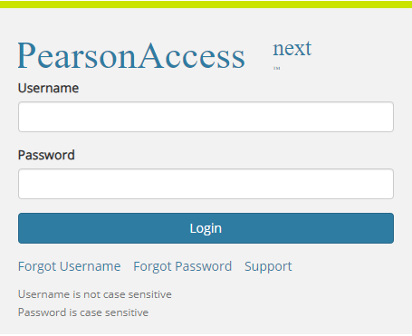
Accessing and Navigating
Accessing PearsonAccess^{next}
aspire.pearsonaccessnext.com
Notes:
The Sign In window will appear.

Slide 6
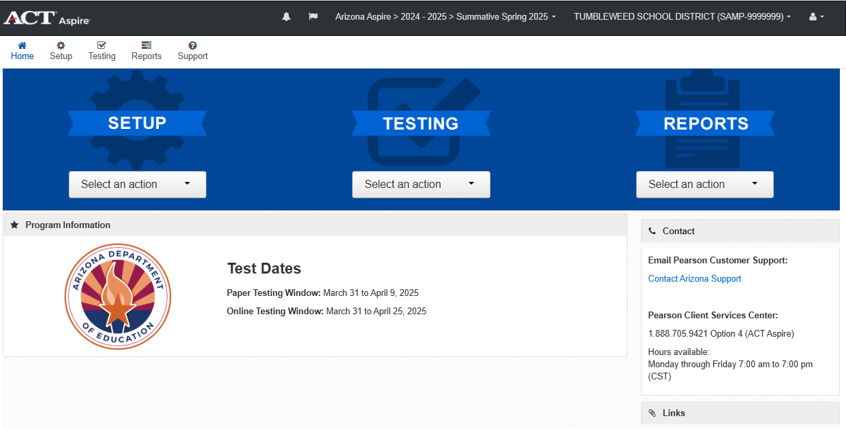
Accessing and Navigating
navigating PearsonAccess^{next}
Main menus
Notes:
After sign in, you will see the PearsonAccess^{next} home screen.
There are three main menus: Setup, Testing, and Reports.
On the home screen, they can be accessed from the middle or the top left of the page.
Either way, they contain the same options.

Slide 7
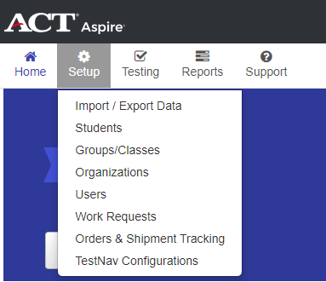
Accessing and Navigating
navigating PearsonAccess^{next}
Setup > Users
Notes:
Select a category from one of the three main menus.

Slide 8
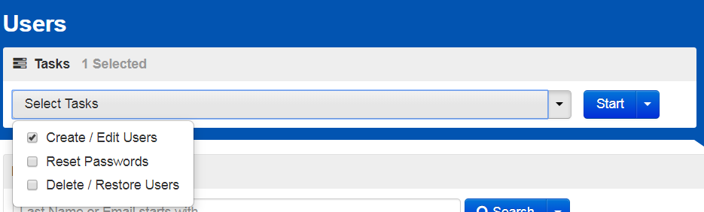
Accessing and Navigating
navigating PearsonAccess^{next}
Task Menus
Notes:
Once you’ve used the main menus to navigate to a specific page, you also have options for navigating the Task menus on those pages.
You can select one or more checkboxes in the “Select Tasks” dropdown on the left.

Slide 9
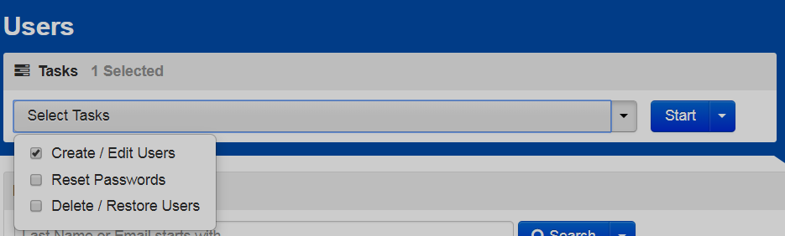
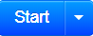
Accessing and Navigating
navigating PearsonAccess^{next}
Task Menus
Notes:
Next, you’ll click the “Start” button.

Slide 10
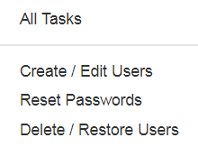
Accessing and Navigating
navigating PearsonAccess^{next}
Task Menus
Notes:
Alternatively, you can click the dropdown connected to Start, on the right, and select one or All Tasks.

Slide 11
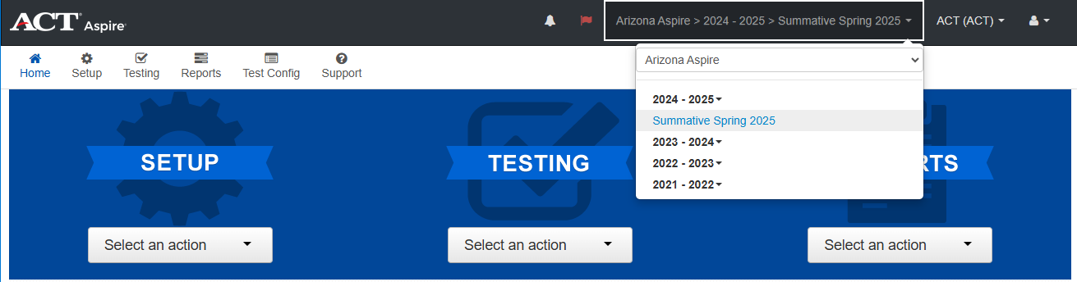
Accessing and Navigating
Changing administrations
Notes:
To navigate between multiple administration years, open the Administration dropdown menu and click the desired administration year.
We recommend checking your administration every time you log in to ensure you’re logged in to the correct administration.

Slide 12
ACT Aspire Testing Process
Notes:
Next, we will take a quick glance at the overall ACT Aspire testing process.

Slide 13

ACT Aspire Testing Process
Combined Flow
Invite Users
Student Registration Import
Personal Needs Profile
Groups/Classes
Technology Setup & Configuration
Set Up Test Sessions
Receive Test Materials
Prepare Test Sessions
Print Tickets
Start Test Sessions
Administer
the Test
Post Test
Clean Up
Return Test Materials
Delivery Date
Shared process
Paper
Online
Notes:
There are many steps to the ACT Aspire testing process – for both paper and online testing. This process flow shows all steps for both types of delivery.
A separate test administration training, published on the Arizona ACT Aspire Support Page, covers more in-depth information for administering the ACT Aspire.

Slide 14
Online Testing Technical Readiness Steps
Notes:
Now we will discuss Online Testing Technical Readiness.

Slide 15
Online Testing Technical Readiness Steps
Technology Setup & Configuration
Invite Users
Student Registration Import
Personal Needs Profile
Groups
Technology Setup & Configuration
Setup Test Sessions
Receive Test Materials
Prepare Test Sessions
Print Tickets
Start Test Sessions
Administer
the Test
Post Test
Clean Up
Return Test Materials
Delivery Date
Shared process
Paper
Online
Notes:
To ensure a successful ACT Aspire administration, it is important to have the correct technology setup and configurations for TestNav.

Slide 16
Online Testing Technical Readiness Steps
Technology Setup & Configuration
Install TestNav on testing devices
Automatic Updates
  Chrome
  iPadOS
  Windows (if downloaded from Windows Store)
Manual Download and Install
  macOS
  Linux
  Windows (if downloaded directly from download.testnav.com)
  download.testnav.com
Notes:
Step 6 of the ACT Aspire testing process is to install the current version of TestNav on all testing devices.
Pearson designed TestNav apps to update with minimal effort from our users. TestNav apps are released once a year in June.
After the updated version is released, the app automatically updates the next time it is launched on the following operating systems:
Chrome
iPadOS
Windows (if downloaded from the Windows Store)
You must manually download and install the updated TestNav app from download.testnav.com for the following operating systems:
macOS
Linux
Windows (if downloaded directly from download.testnav.com)

Slide 17
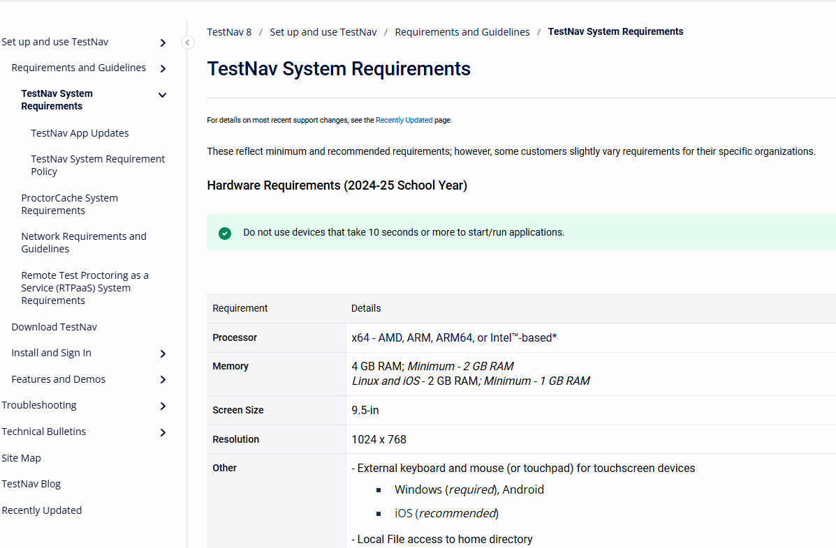
Online Testing Technical Readiness Steps
TestNav - System Requirements
https://support.assessment.pearson.com/x/HwYcAQ
Notes:
TestNav is the application the students will need to take an online test. It needs to be installed on all the testing devices.
TestNav System Requirements are posted to the TestNav Online Support page. Here, we are showing the TestNav System Requirements page. The “Recently Updated” link on this page details the newest changes to the requirements.
We have also noted the link to the system requirements on the Resources List at the end of this webinar.

Slide 18
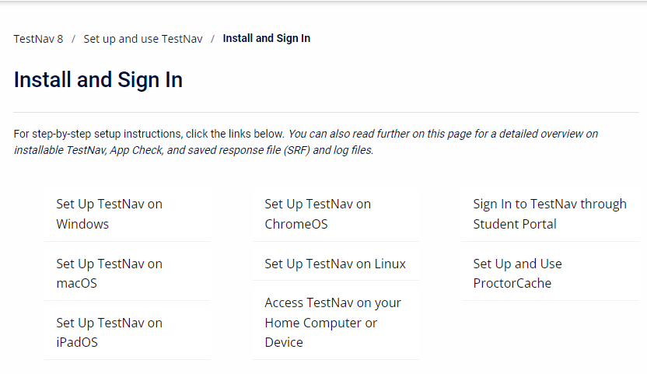
Online Testing Technical Readiness Steps
TestNav – Install and sign in
https://support.assessment.pearson.com/x/Jif1AQ
Notes:
On the Install and Sign In support page, there are links to navigate to pages with specific, step-by-step instructions for setting up TestNav on the listed operating systems.

Slide 19
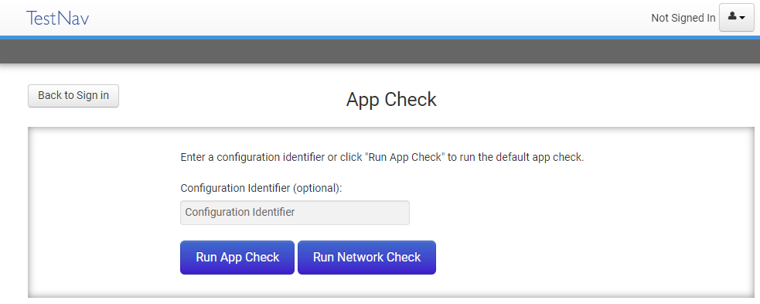
Online Testing Technical Readiness Steps
TestNav - Install and sign in
Notes:
As part of the Install and Sign In process, the instructions will lead you through the “App Check” process.
“App Check” confirms that the device or computer can connect to TestNav and that it is configured to start TestNav in kiosk mode.

Slide 20
Online Testing Technical Readiness Steps
TestNav – CHROMEBOOKS
https://support.assessment.pearson.com/x/NgccAQ
Pearson supports only managed Chromebooks for secure testing. Both before you install TestNav AND prior to each testing session, you should check each device to ensure it is in managed status.
For testing, note which specific device each student uses during each test. The TestNav app saves Saved Response Files (SRFs) to only one designated place on the testing device. If an error occurs, you can locate files only on that specific device.
Students with accommodations or accessibility features enabled through their Personal Needs Profile (PNP) or test form access those features within TestNav. ChromeOS has native accessibility features that might appear within a kiosk floating accessibility menu during testing. Technology personnel must disable this menu before testing to avoid it interfering with the student’s test.
Notes:
This link provides Chrome OS specific installation instructions.
Here we share some top tips for schools using Chromebooks.
Pearson supports only managed Chromebooks for secure testing. Both before you install TestNav AND prior to each testing session, you should check each device to ensure it is in managed status.
For testing, note which specific device each student uses during each test. The TestNav app saves SRFs (Saved Response Files) to only one designated place on the testing device. If an error occurs, you can locate files only on that specific device.
Students with accommodations or accessibility features enabled through their Personal Needs Profile (PNP) or test form access those features within TestNav. ChromeOS has native accessibility features that might appear within a kiosk floating accessibility menu during testing. Technology personnel must disable this menu before testing to avoid it interfering with the student’s test.

Slide 21

Online Testing Technical Readiness Steps
TestNav – CHROMEBOOKS
Convertible Chromebooks
Chromebooks must be used in laptop mode for use with TestNav
Tablet mode is not supported by TestNav
Notes:
Please note, while convertible Chromebooks are supported by TestNav, they may only be used in laptop mode.
TestNav does not support convertible Chromebooks in tablet mode.

Slide 22

Online Testing Technical Readiness Steps
TestNav – MOBILE DEVICES- IPADS
https://support.assessment.pearson.com/x/OAccAQ
Prior to testing, be sure to:
Familiarize yourself with the default primary save location.
Configure the secondary save location through PearsonAccess^{next}
The same secondary save location applies to all computers and devices. You only need to set this configuration one time.
Communicate procedures for locating SRFs (Student Response Files) and log files to proctors
Note which student tests on which device during infrastructure trials and on test days.
Notes:
TestNav for iPads
This link provides iOS specific installation instructions.
In addition to installing TestNav, you will want to be sure to complete these tasks prior to testing.
Familiarize yourself with the default primary save location
Configure the secondary save location through PearsonAccess^{next}
Communicate procedures for locating SRFs (Student Response Files) and log files to proctors
Note which student tests on which device on test days.

Slide 23





Online Testing Technical Readiness Steps
IPADS – ASSESSMENT TIMER
iOS will exit kiosk mode after 8 hours
Determine if student(s) will exceed the allotted time
Plan a break for student(s) to sign out prior
If time expires, restart the iPad and resume the student(s)
Notes:
Apple only allows an app to run in single app, or kiosk mode, which is used by TestNav for a specific amount of time before it automatically takes the device out of kiosk mode. This affects the length of time TestNav is able to run after a student signs in to a test. For iOS, that time limit is 8 hours.
If the time limit expires, and the student is exited from the test, the Room Supervisor must resume the student’s test in PearsonAccess^{next}, restart the iPad and the TestNav app, and then have the student sign in again.
To ensure the smoothest testing experience, Room Supervisors should have a plan to determine if students will exceed the 8-hour time limit and plan for a break before the limit is reached.

Slide 24
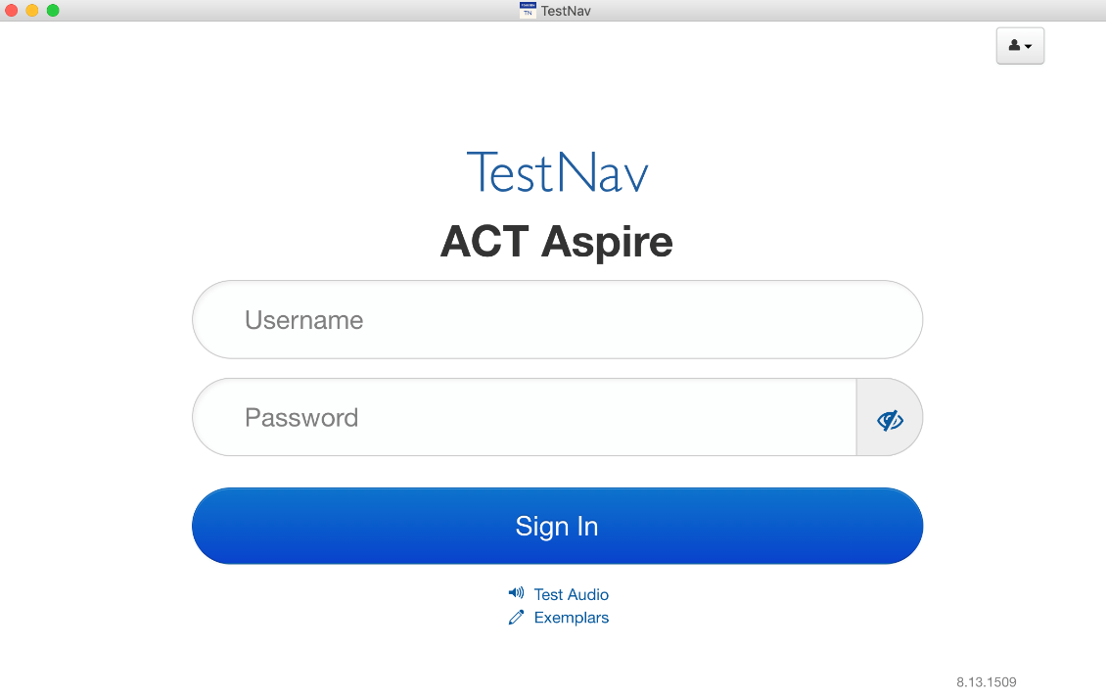
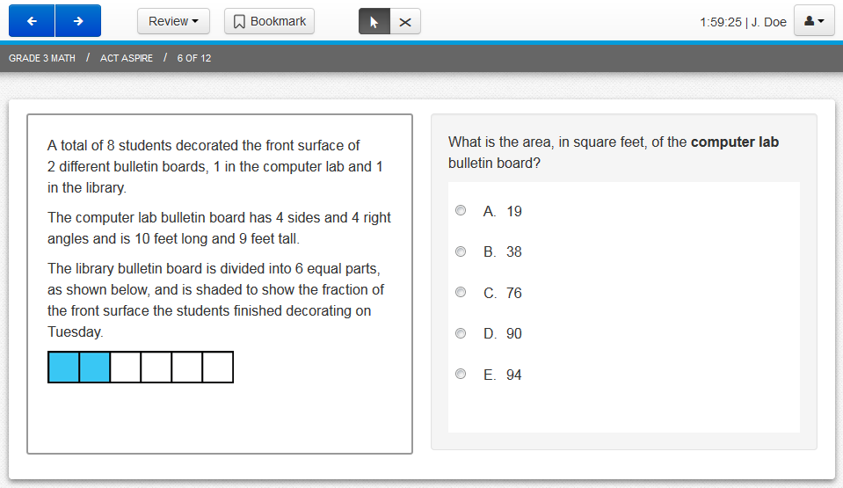
Online Testing Technical Readiness Steps
ACCESSING TestNav
TestNav is the secure student testing application
Notes:
Now we’ll talk about accessing TestNav, the secure student testing application.

Slide 25
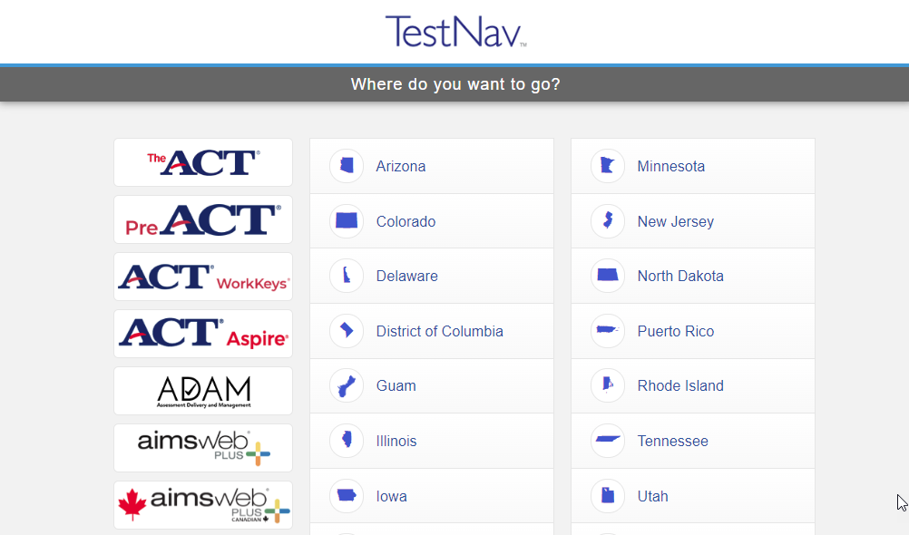
Online Testing Technical Readiness Steps
ACCESSING TestNav
The customer selection screen displays upon initial launch of the TestNav apps
Notes:
On the initial launch of the TestNav app, the customer selection screen will display.
Select ACT Aspire from the customer selection screen.

Slide 26
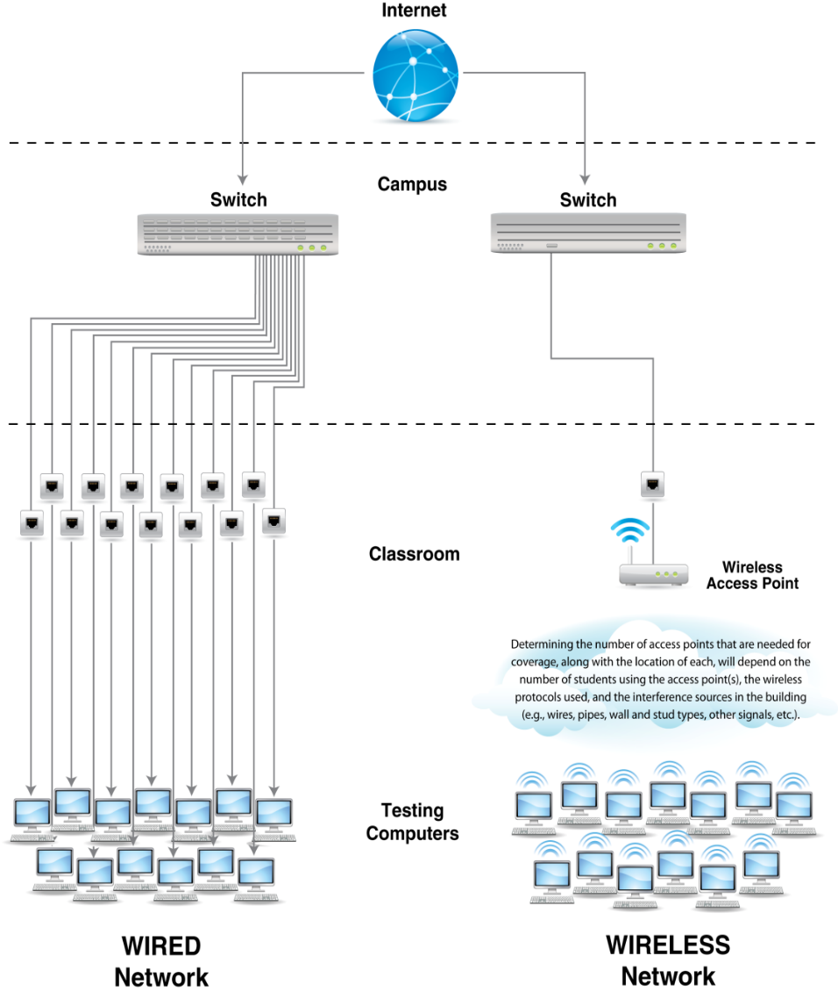
Online Testing Technical Readiness Steps
WIRELESS TESTING: BEST PRACTICES
Wireless access points – more is better
Limit computers per wireless access point
Distance – closer is better
Limit obstructions
Test performance before scaling
Notes:
The increase in devices accessing school networks increases the need for stable Wi-Fi networks, daily monitoring, and maintenance. These recommendations follow best practices for online testing:
Wireless access points – more is better
Limit computers per wireless access point
Distance – closer is better
Limit obstructions
Test performance before scaling

Slide 27

Online Testing Technical Readiness Steps
DISABLE AUTOMATIC APPLICATIONS
Anti-virus software
Power management software
Screen savers
IM Applications
E-mail message notification
Notes:
Be sure automatic applications such as anti-virus and power management software, screen savers, Instant Messaging applications, and e-mail notifications are disabled from testing devices.

Slide 28
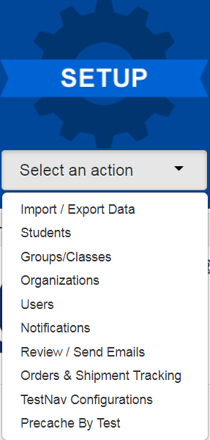
Online Testing Technical Readiness Steps
SETUP - TestNav CONFIGURATIONS
Notes:
Now, we’ll cover TestNav configurations.
Select TestNav Configurations under the Setup menu.

Slide 29
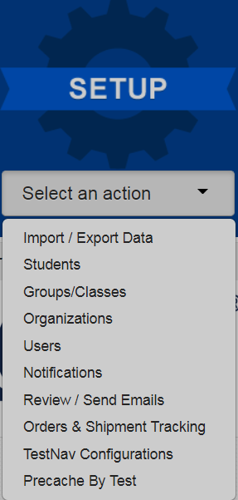
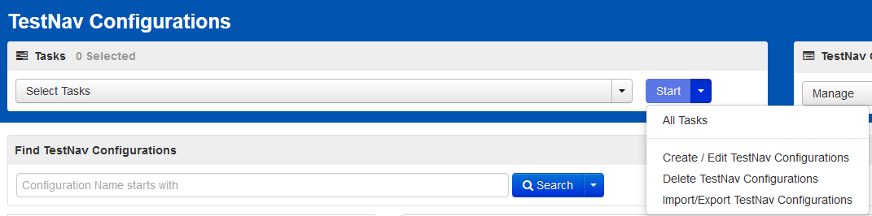
Online Testing Technical Readiness Steps
SETUP - TestNav CONFIGURATIONS
Notes:
Select Create/Edit TestNav Configurations or All Tasks.

Slide 30
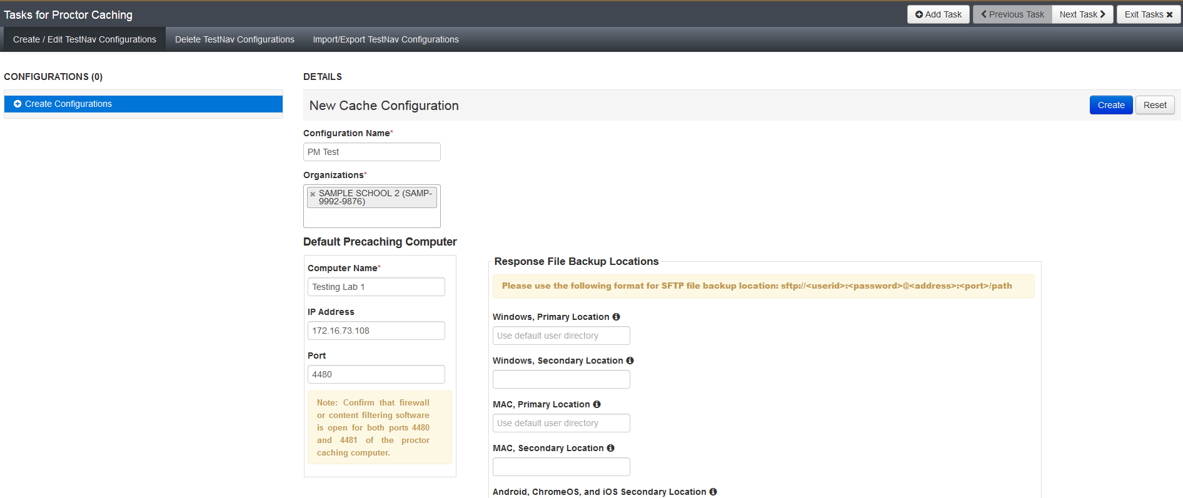
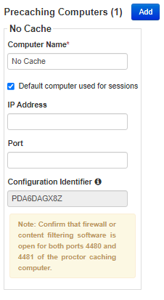
Online Testing Technical Readiness Steps
SETUP - TestNav CONFIGURATIONS
Notes:
Fill in the fields based on ProctorCache computer information.

Slide 31
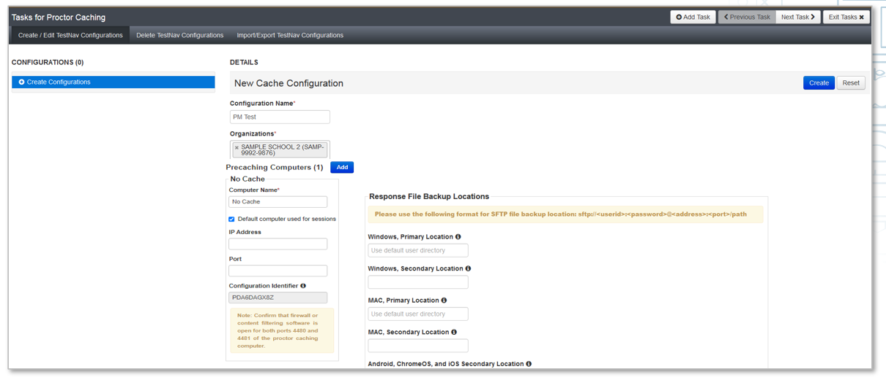
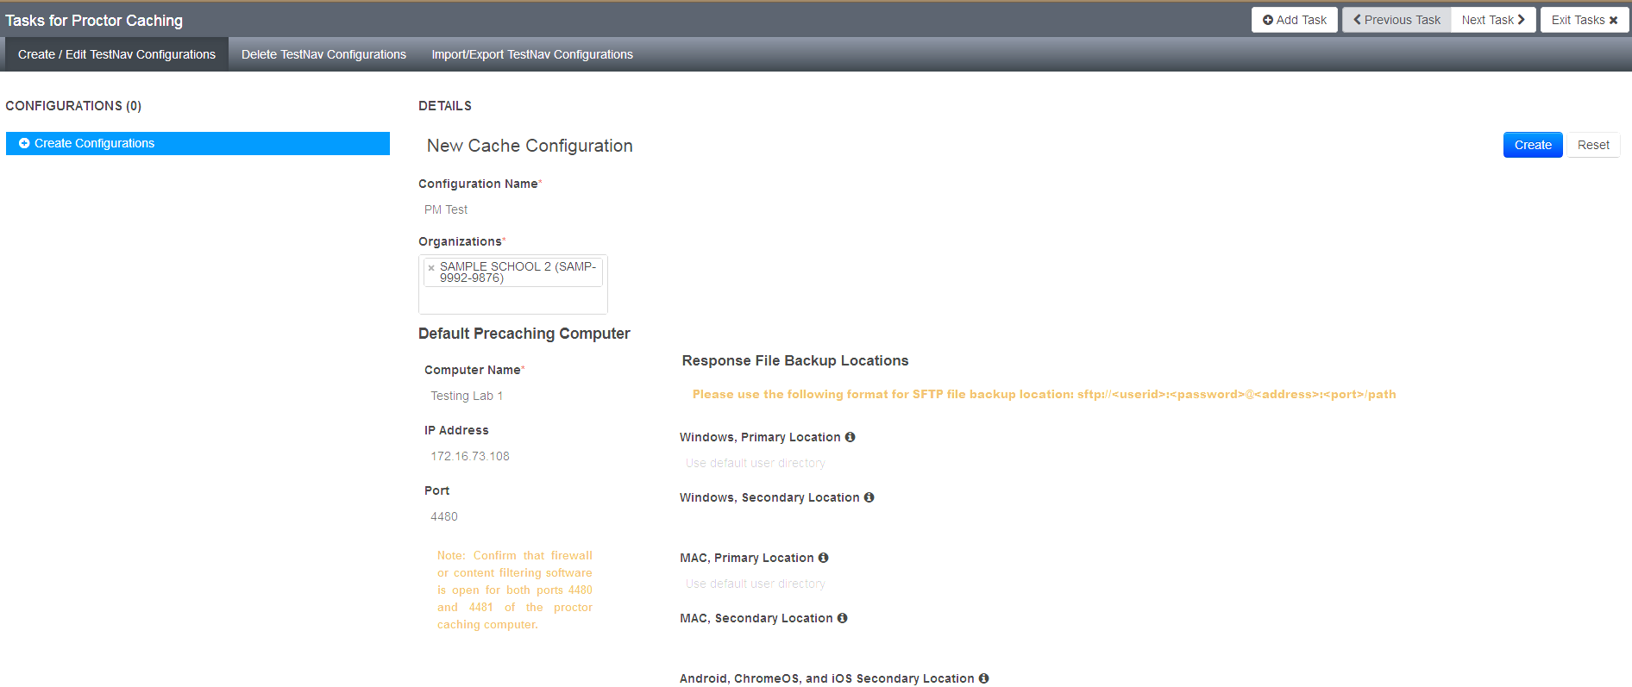
Online Testing Technical Readiness Steps
SETUP - TestNav CONFIGURATIONS
Notes:
Then click “Create.”
This must be completed prior to test session creation.

Slide 32
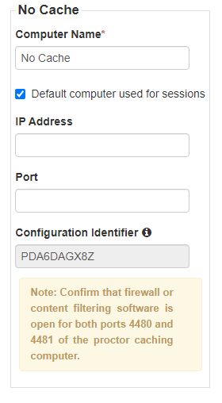
Online Testing Technical Readiness Steps
SETUP – CONFIGURATION IDENTIFIER
Notes:
Once you have successfully created your configuration, a Configuration Identifier should then appear.
This is used inside of App Check to ensure PearsonAccess^{next} is configured properly with TestNav, ProctorCache, and your Save locations.

Slide 33
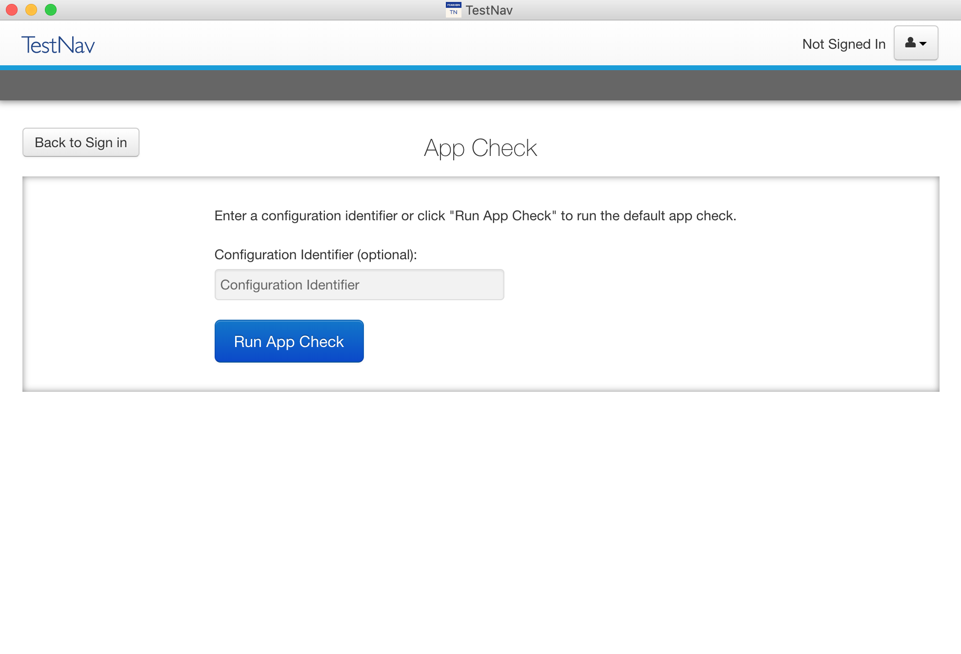
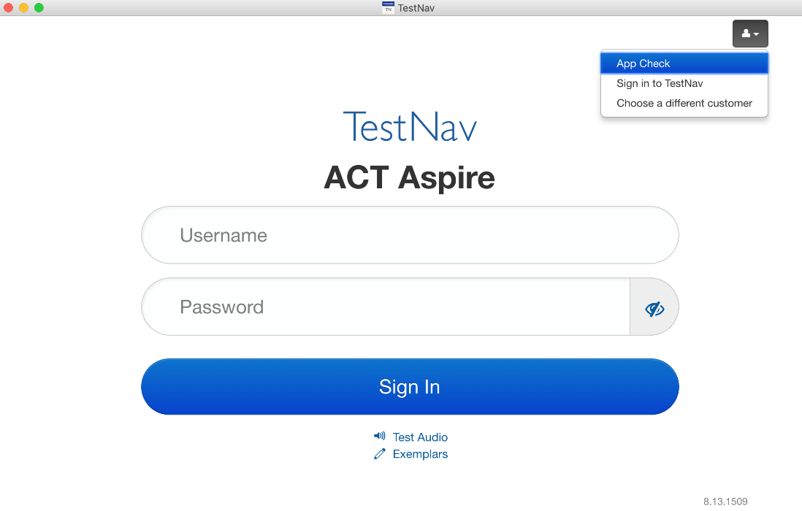
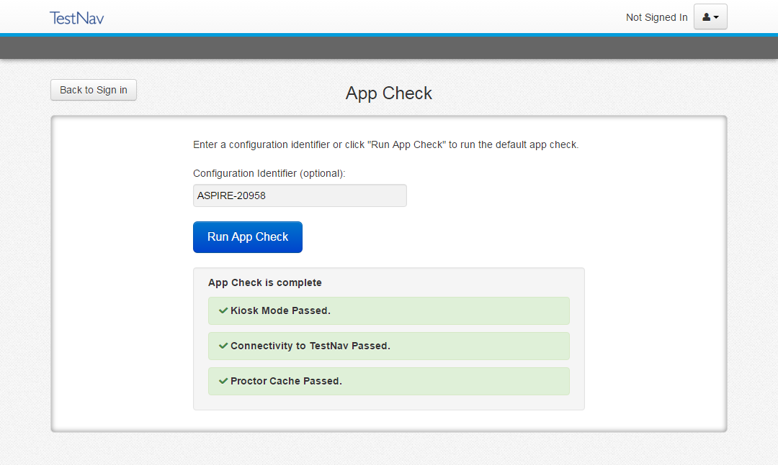
Online Testing Technical Readiness Steps
TestNav – App Check
Notes:
App Check checks the connection to TestNav, ensures kiosk mode can be enabled, as well as checks the ProctorCaching device with a Configuration Identifier created when you configure TestNav in PearsonAccess^{next}.
To run App Check, Select “App Check” from the User Menu in TestNav.
In the App Check window, enter the Configuration Identifier, if applicable, then click “Run App Check.”
The App Check results will display on screen.

Slide 34
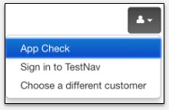
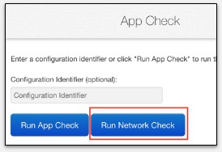
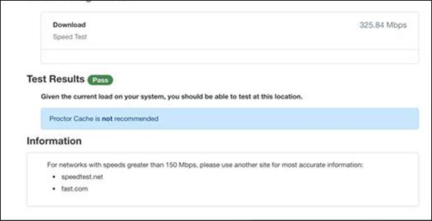
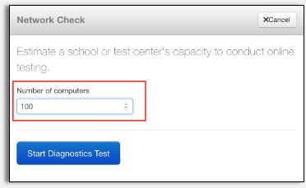
Online Testing Technical Readiness Steps
TestNav – NETWORK CHECK
Notes:
Once you’ve run App Check to confirm TestNav is set up correctly on each student’s computer, run the Network Check. You only need to run the Network Check once.
To run the Network Check:
Click “Run Network Check” from the App Check page.
Enter the number of computers that will be testing at one time.
See the results of the Network Check and recommendations regarding ProctorCache.

Slide 35
Online Testing Technical Readiness Steps
TestNav – COMMON ERROR CODES
Familiarize yourself with the common TestNav error codes
Troubleshoot technical issues during testing
Note the error code and provide to the support agent
Common Error Codes
1001 | Your test has been saved. Please notify your test administrator.
1014 | Unable to download test content.
8029 | The test installed app is out of date and needs to be updated in order to use TestNav on this device.
3005 | TestNav has detected that another application attempted to become the active window, which may compromise the security of this test. TestNav has been shut down. You may need assistance from your test monitor to restart the test.
3018 | The connection to the server has been lost. Please inform your test proctor that the test must close due to a connectivity error.
9058 or 9059 | The username or password you entered is incorrect.
Notes:
Test Coordinators and technology staff should familiarize themselves with the common error codes that may appear on the TestNav application. This will assist in troubleshooting technical issues during testing. For technical issues encountered during testing that require a call to Pearson Customer Support, note the error code number and provide this information to the agent. Make note of the devices each student uses while testing.
The TestNav application saves response files during testing to a primary location on the local testing device, and the student’s response files may need to be retrieved from the device if an error occurs.

Slide 36
Resources
Notes:
Now, let’s talk about some of the ACT Aspire resources that are available to assist you.

Slide 37
Resources
Web pages and Resources
Arizona ACT Aspire Support Page
  https://az-support.mypearsonsupport.com/aspire/
ACT Aspire PearsonAccess^{next} site
  https://aspire.pearsonaccessnext.com/customer/index.action
Download TestNav
  https://support.assessment.pearson.com/x/mgJnAw
TestNav System Requirements
  https://support.assessment.pearson.com/x/HwYcAQ
Install and Sign In to TestNav
  https://support.assessment.pearson.com/x/Jif1AQ
TestNav Error Codes
  https://support.assessment.pearson.com/x/DwACAQ
Notes:
This page contains useful resources that were mentioned throughout this training. We suggest bookmarking the Arizona ACT Aspire Support Page, the ACT Aspire PearsonAccess^{next} site, and the TestNav online support page. We have placed several useful links within the TestNav online support page here for your reference.

Slide 38

Questions?
We’re here to help!
Pearson Customer Support:
Phone: 1.888.705.9421 Option 4 (ACT Aspire)
Hours available: Monday-Friday 7:00 am - 7:00 pm (CST)
Notes:
This concludes the ACT Aspire Technical Readiness training. If you have any questions, please contact us at the number provided on this slide.

